Slide 1



Train Ticket Reservation
Presented By Team Explorers
Amit Kumar Yadav
Deepak KasuMurthy
Dhirendra Kumar Singh
Hari Chitturi
Rachana Nataraj

Slide 2
The Train Reservation System facilitates the passengers to enquire about train availability on the basis of Source and Destination and book the ticket.
The aim of this project is to design and develop a database maintaining records of different trains and facilitates to book a ticket.
It is the computerized system in which the ticket is auto generated that includes all the information regarding the journey of the passenger.
Introduction

Slide 3
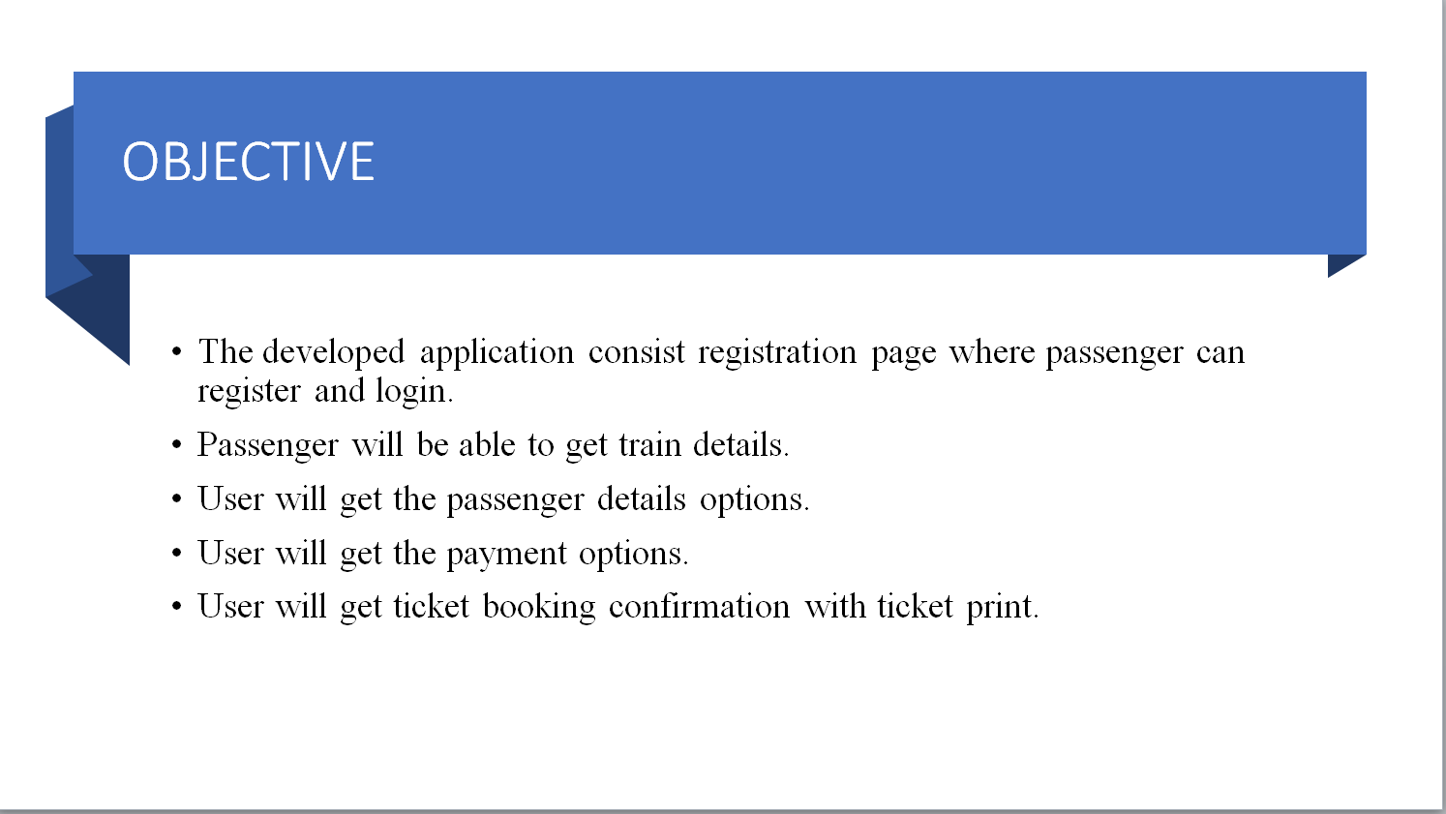

Slide 4
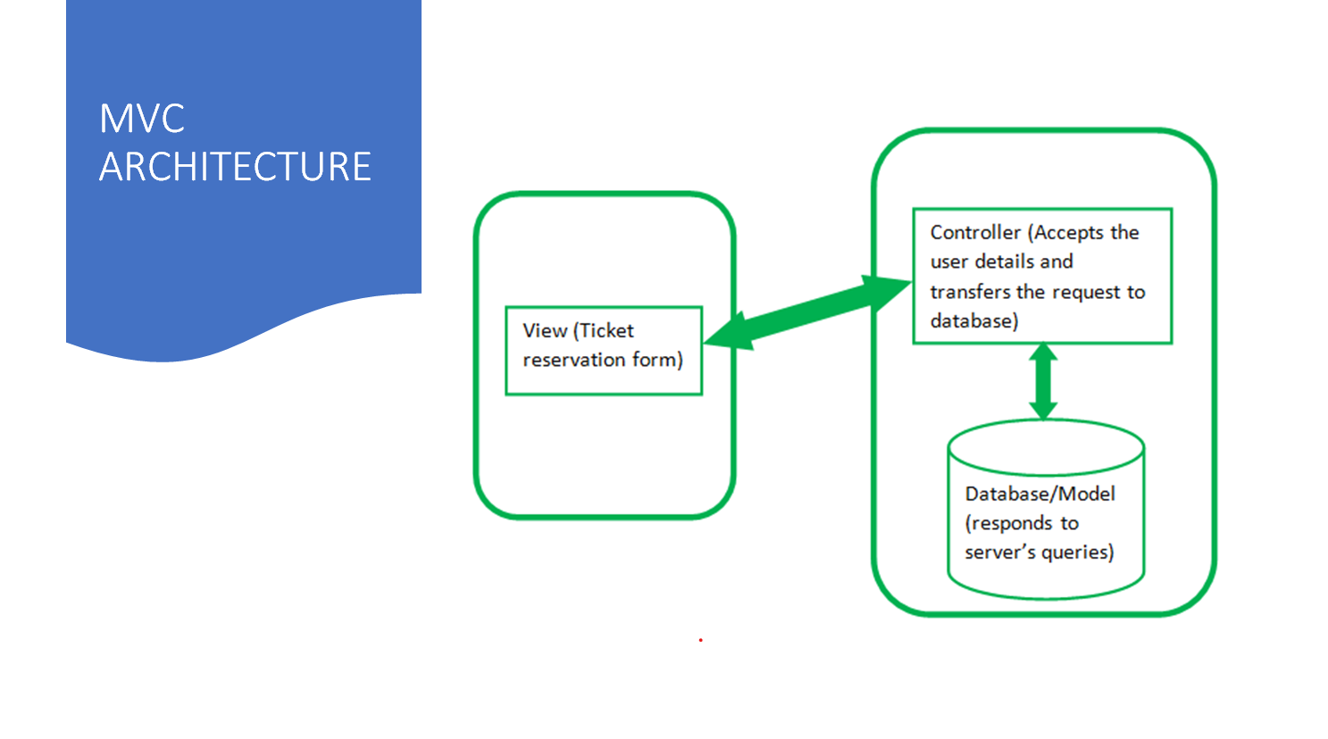

Slide 5




Technologies Used
JDBC
JavaScript
HTML5
CSS3
MYSQL
Spring Boot

Slide 6
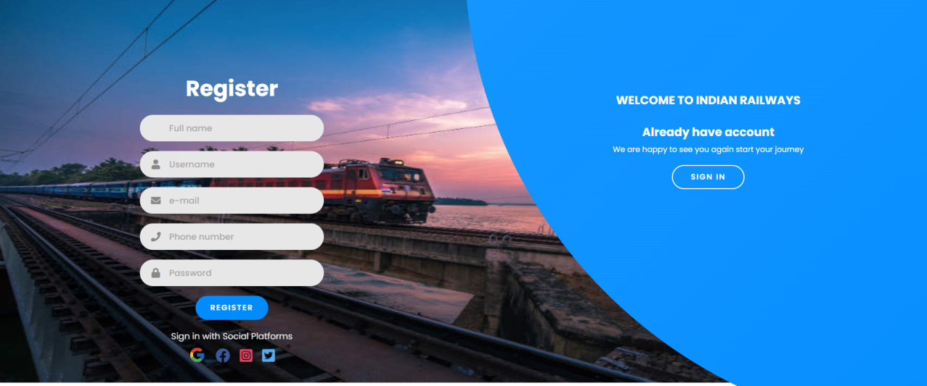
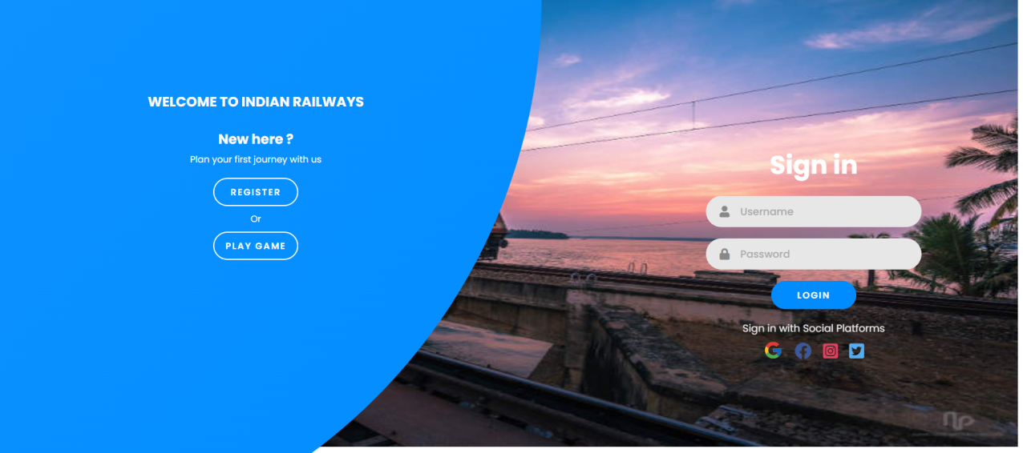
Results

Slide 7
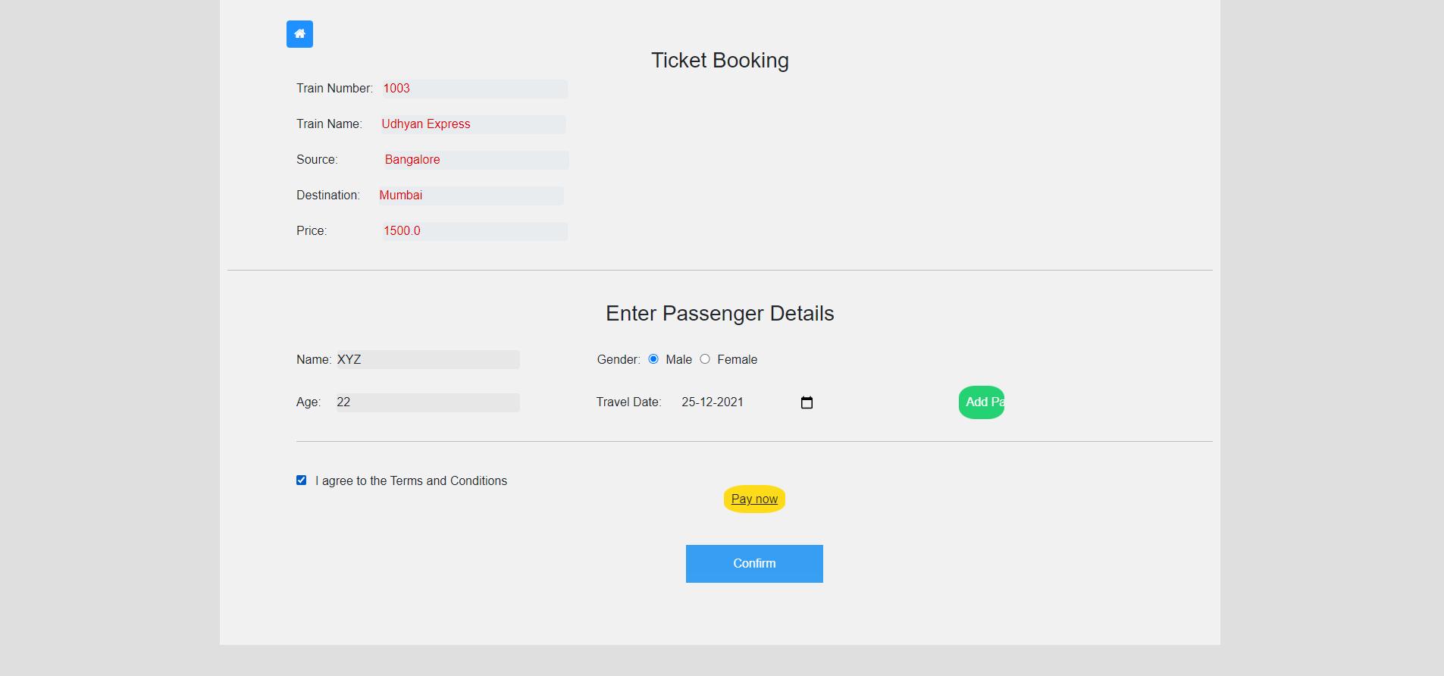
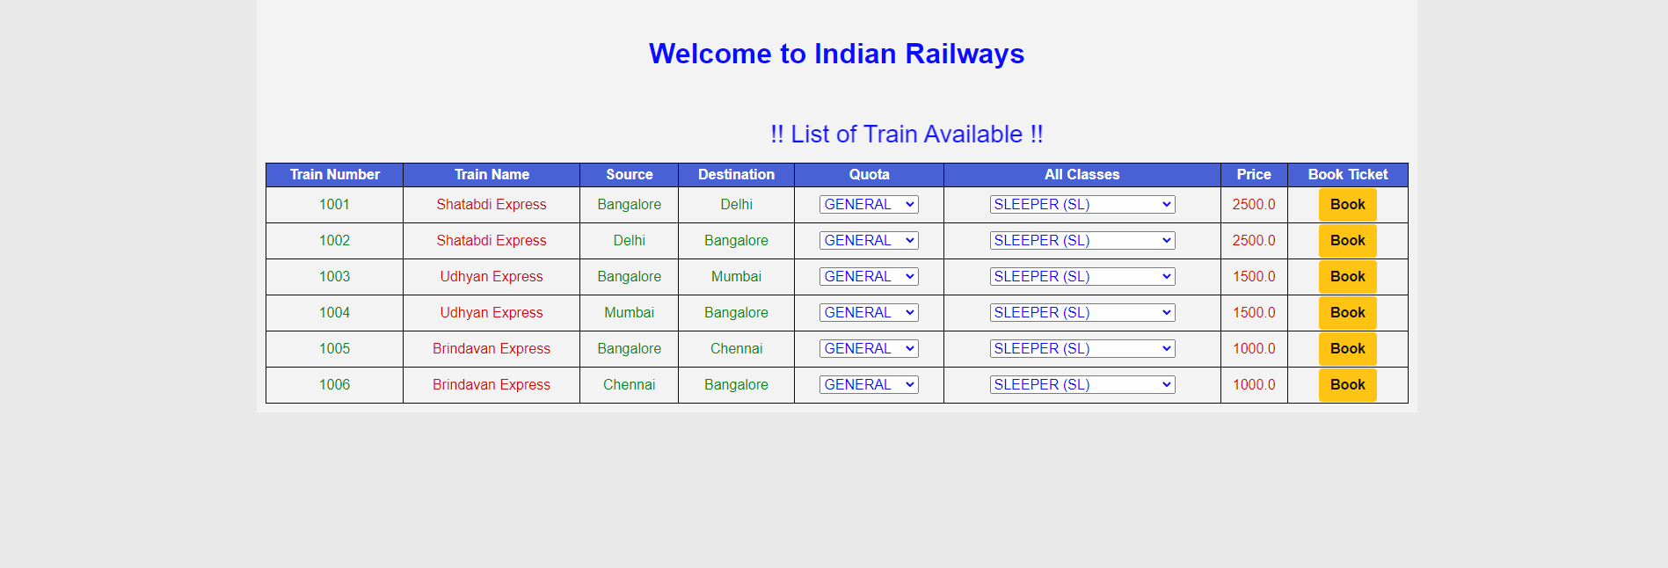
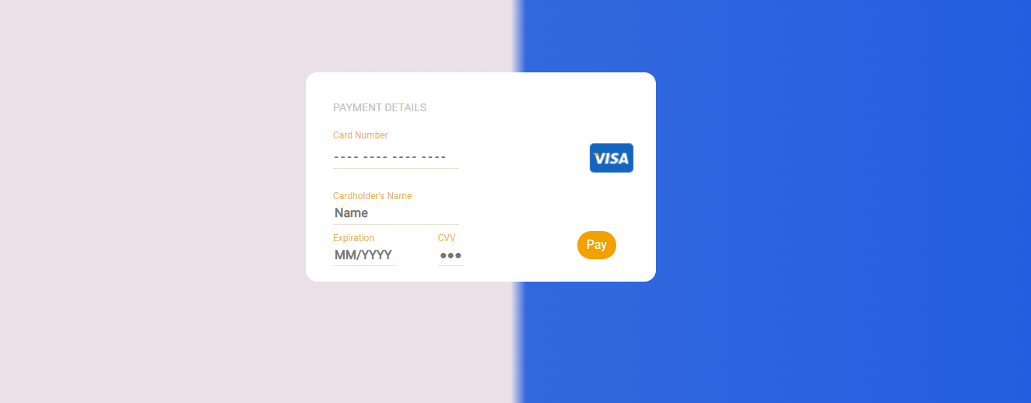
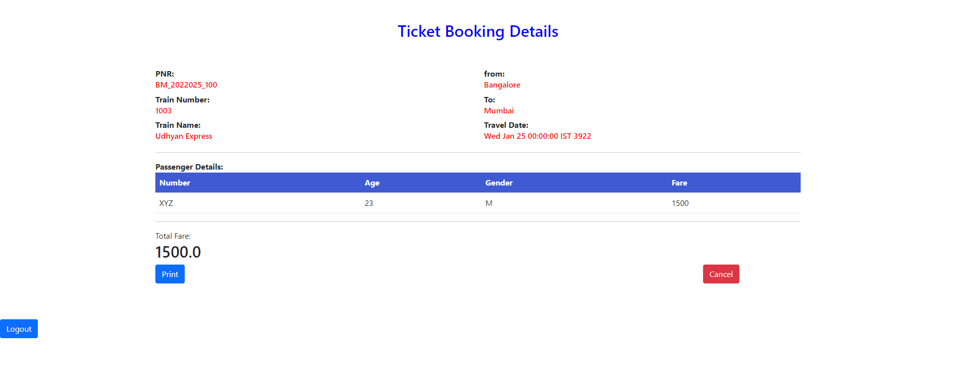

Slide 8
Thank You

